Slide 1
ToDo
Comparing fuzzing speed and crash detection ability of AFL++ normal mode and that of persistent mode
On programs with known crashes
With address sanitizer or without address sanitizer
Implementing automated global variable reinitialization for AFL++ persistent mode
Developing (ideas for) automated deferred initialization and shared memory test cases

Slide 2
Target Programs
bison-3.7
cflow-1.6
binutils/nm 2.36.1
binutils/size 2.36.1
exiv2 0.27.2

Slide 3
Target Programs
bison-3.7
Building a parser from a given context-free grammar
Be careful about the installed location
Without sanitizer
Persistent mode wrapping main impossible without reinitialization
cflow-1.6
Building a control-flow graph from a given C source file
Without sanitizer
Persistent mode wrapping main impossible without reinitialization

Slide 4
Target Programs
binutils/<nm|size> 2.36.1
nm
Lists the memory locations for each symbol in each binary file
size
Lists the section sizes for each object in each binary file
With address sanitizer
Persistent mode wrapping main possible without reinitialization

Slide 5
Target Programs
exiv2 0.27.2
Print the metadata for a given input exif file (with “pr” option)
Without sanitizer
Persistent mode wrapping main possible without reinitialization

Slide 6
AFL++ Configuration
AFL++ 4.00c LLVM-PCGUARD mode (default mode)
Fuzz driver for
Normal mode: compile bison using afl-clang-fast with no modification
PM: wrap whole main function with the __AFL_LOOP as the fuzzing target; compile using afl-clang-fast; no state re-initialization
DI, DI+STC, DI+STC+PM (not yet)
Seed inputs Ahcheong provides
No sanitizer for bison, cflow, and exiv2; and address sanitizer for binutils
12 hours time-limit

Slide 7
Results: binutils
For nm
No found crash for both Normal and PM
No speed-up when using PM wrapping main
For size
Found crashes with no meaningful difference between normal and PM
Speed-up when using PM wrapping main
 | exec/sec | bitmap_cvg | stability | saved crashes
Normal | 480.43 | 3.80% | 100.00% | 0
PM | 461.51 | 3.81% | 100.00% | 0
 | exec/sec | bitmap_cvg | stability | saved crashes
Normal | 417.38 | 2.95% | 100.00% | 7
PM | 991.31 | 3.14% | 99.49% | 10

Slide 8
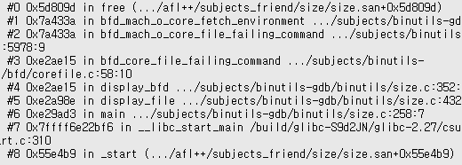
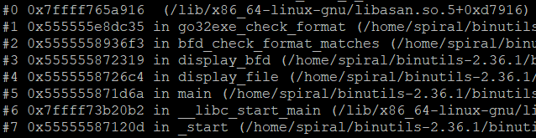
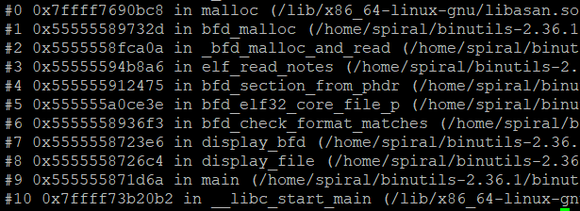
Found Crashes on size
Stack trace of the known crash
Stack trace of crashes that both normal and PM found
Stack trace of a crash that PM found

Slide 9
Results: exiv2
No found crash for both Normal and PM
Speed-up when using PM wrapping main
 | exec/sec | bitmap_cvg | stability | saved crashes
Normal | 2619 | 7.92% | 100.00% | 0
PM | 8545 | 8.22% | 99.20% | 0

Slide 10
Automated Global Variable Reinitialization
Using LLVM pass to extract global variables and their initializer for each source file
LLVM::ModulePass visits each LLVM::Module (file) of a program.
A LLVM::Module maintains the list of LLVM::GlobalVariables
A LLVM::GlobalVariable may have LLVM::Constant as an initializer
Only constants can initialize global variables

Slide 11

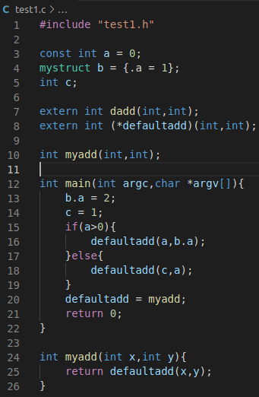
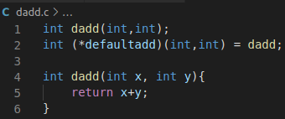
Example Program with Global Variables
Variable initialized with a constant variable
Constant variable, which should not be reinitialized
Variable initialized with an aggregate element (struct/array/vector)
External variable from dadd.c, which should be reinitialized in the file dadd.c, not test1.c
Variable without initialization

Slide 12

Global Variable Extraction Example (On going)
Constant variables are filtered out
Function declarations are omitted
test1.c
dadd.c
Fail to initialize with an aggregate element
Need different initialization according to the variable type
test1.c.gbi
dadd.c.gbi
Initialize a variable with no initializer
Success to initialize a variable initialized by a constant variable using the name of initializer
Fail to filter out extern variables

Slide 13
Next ToDo
Implementing automated global variable reinitialization for AFL++ persistent mode
Comparing fuzzing speed and crash detection ability of AFL++ normal mode and that of persistent mode with reinitialization
On programs with known crashes
With address sanitizer or without address sanitizer
Triaging crashes using stack trace comparison
Developing (ideas for) automated deferred initialization and shared memory test cases

